Slide 1
Autoencoders Ensemble for Anomaly Detection on Data Pipelines
- When Data Engineer and Data Science get together!

Slide 2

Topics
Introduction
The Problem
Methodology
Results and Learnings

Slide 3
Who am I?

Slide 4
Data-WHAT???

Slide 5




Data Trinity
Data Engineer
The data engineer ensures that all data is properly extracted, transformed, stored, and made accessible to other users.
Main Tech Skills:
Python / Scala
SQL, NoSQL, APIs
Spark, Hadoop
Cloud (AWS, GCP)
Data Science
A data scientist is a specialist who applies their expertise in statistics and machine learning building data products, which make predictions and automate tasks.
Main Tech Skills:
Python / Scala
ML libs: Scikit-learn, Pytorch, Keras, Tensorflow.
Data Analytics
Data Analysts deliver value to their companies by analysing data, using it to answer business questions, and communicating the results to help make business decisions.
Main Tech Skills:
SQL
Data visualization: Tableau, Metabase, PowerBI.

Slide 6

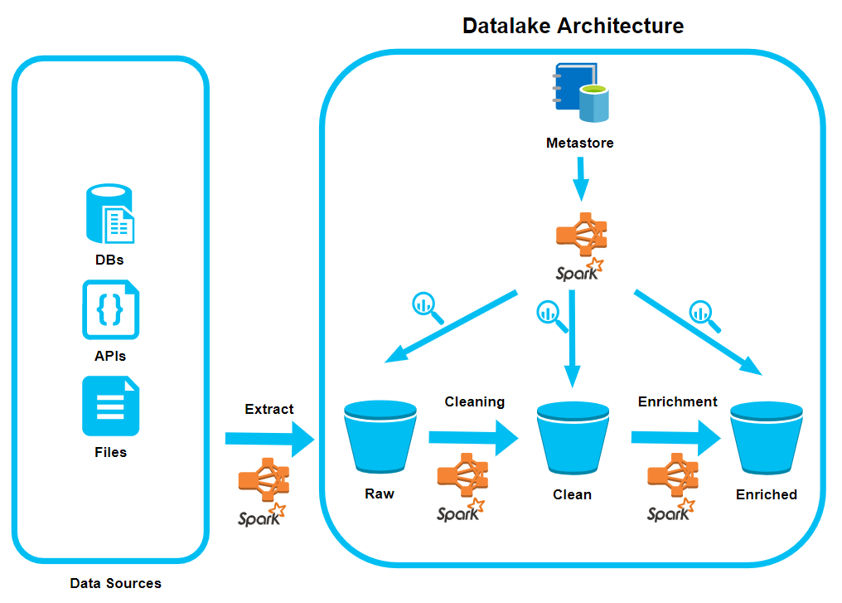
Modern Data Platforms

Slide 7
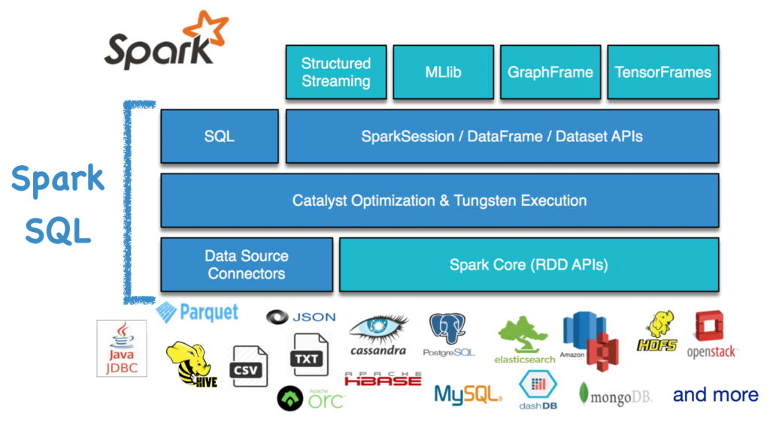

Slide 8
The Problem

Slide 9

What can get wrong?
“Runtime Errors” are easy to spot, data inconsistency don’t!
Spark is flow-oriented, distributed, functional and async -> hard to handle errors
Several data-pipelines and data sources extractions runs everyday, how to monitor all of them?
“Garbage In, Garbage Out” - George Fuechsel

Slide 10

Objective
Create a data product that can spot inconsistencies in daily data processing tasks
Machine learning is used for such job, more specifically an Autoencoder Ensemble Neural Network
The learn is based on the past historical “ingestions” of the dataset (data profile)

Slide 11

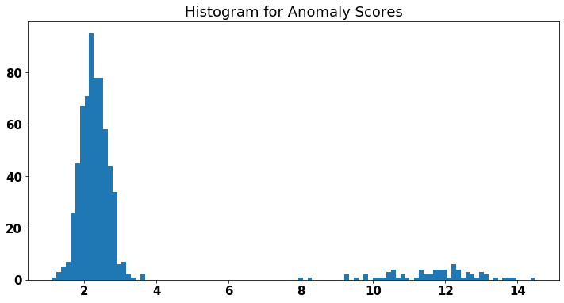
Autoencoders for Anomaly Detection
Train a autoencoder using your data (MSE loss)
The “predict” is the distance between the point generated and the original
We aim the model to generated short distances on normal points and huge distances on outliers
We need to be careful with outliers fitting and generalize models as much as possible

Slide 12
Methodology

Slide 13

Machine Learning Pipeline
Business
Problem
Acquire and prepare data
Model validation
Test and Insights
Deploy Product
Monitor and optimize

Slide 14

Created Features
n_rows
null_values_ration
max_value_numeric_cols
min_value_numeric_cols
avg_value_numeric_cols
max_length_string_cols
min_length_string_cols
avg_length_string_cols
+plus 7d_moving_avg each

Slide 15
Results

Slide 16

Model validation (72 models - 5-fold)
Top 1: layers=[16, 8, 4, 2, 4, 8, 16], dropout_rate=0.2, l2_regularizer=0.01
Top 2: layers=[16, 8, 4, 8, 16], dropout_rate=0.1, l2_regularizer=0.01
Top 3: layers=[16, 14, 10, 6, 10, 14, 16], dropout_rate=0.2, l2_regularizer=0.01
Top 4: layers=[16, 12, 8, 4, 8, 12, 16], dropout_rate=0.1, l2_regularizer=0.01
Top 5: layers=[16, 16, 12, 8, 12, 16, 16], dropout_rate=0.2, l2_regularizer=0.01
* All of them with ReLU in the hidden layers and Sigmoid in the output layer

Slide 17

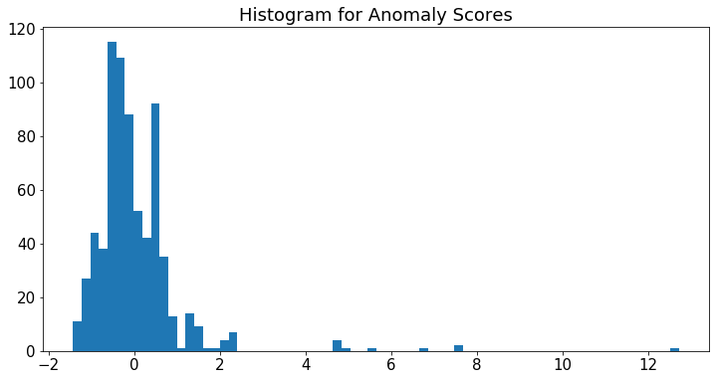

Test and Insights
10 anomalies discovered in my historical data
3 differentes cases
1 probably is major incident
The other 2 need investigation
Artificial anomalies tests: 4/6
n_rows, nulls_ratio, int overflow and avg_string_length

Slide 18
Learnings

Slide 19

Learnings
Great experience, since I handled the end-to-end ML Pipeline
Solving a real world problem is motivational
The initial metrics may not produce the desired results
Infrastructure and optimizations can be a pain
Feature engineering and understanding of the business can be more important than the “modeling” itself.
Thinking in the product flexibility and scalability is crucial

Slide 20
Questions?
Linkedin: /in/rafaelleinio/

